Slide 1


amadeus | Travel Now
Inspiration based travel
Oct 21st 2013

Slide 2
Travel Now
Inspiration based travel
“Tourists don’t know where they’ve been, travelers don’t know where they’re going.” – Paul Theroux

Slide 3
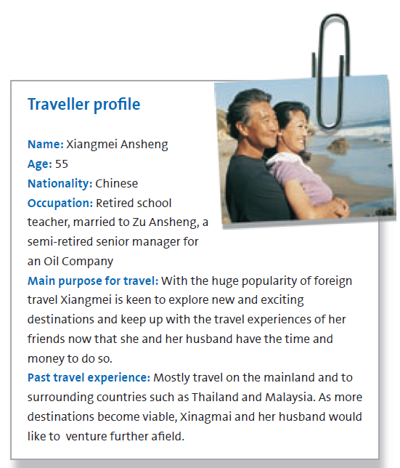
Let us begin our journey with..
Mrs. Xiangmei Ansheng, aged 55 years & Mr. Zu, aged 58 years want their retirement to be a new chapter in their lives
They are keen to explore new and exciting destinations for health & wellbeing , learning/cultural holidays & ethical voyages.
With this “travel inspiration” Travel Now suggests a list of destinations catering these desires

Slide 4
Trip planning…
The couple finds a suggestion exciting and goes on to check the details
“Travel Now” shows the
Geographic location on a map
Best promotional offer available for the trip
Destination details
Popular events happening on health & wellbeing, cultural festivals & spirituality
Time to book the tickets for Mr. & Mrs. Ansheng

Slide 5
Travel Now
Inspiration based travel

Slide 6
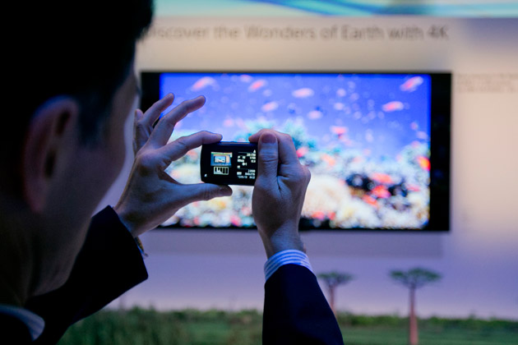
Amadeus – About us
Who are we?
A world-leading technology and distribution solutions provider
We deliver unparalleled expertise to the travel and tourism industry
In particular, we believe that technology must help travelers interact more intuitively with their providers something we call the “humanization of technology”.
What we do?
Provide leading-edge solutions that cover airlines’ unique business needs, independent of their size, business model or market reach.
“Personalization” of travel experience
Focus on highly personalized, streamlined and flexible journey
Creating traveler-centric experiences
Why?
Products
Future travelers will be more sophisticated, knowledgeable and demanding.
Affluence, education and choice will raise expectations.

Slide 7
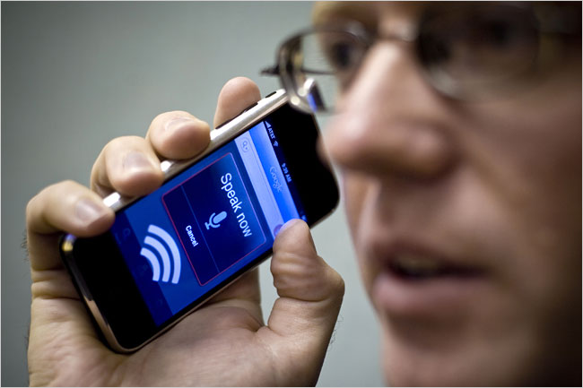
Voice based search
This prototype demonstrates
How the search page contents can be filled with data from voice
Voice is first converted to text using Google Voice
Text is parsed using EVA and the result is then used to fill search form
Expert Virtual Agent (EVA), enables free-text search for travel
It understands the users' inputs and converts them to structured search queries
Google Voice transcription, enables speaking search queries instead of typing
Similar prototype on iOS
Using OpenEars
shared-source iOS framework for iPhone voice recognition
all processing occurs locally on the device!

Slide 8
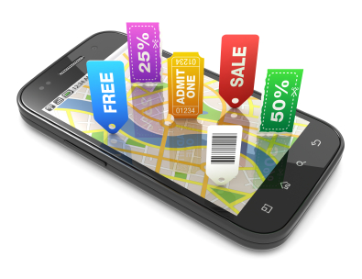
Geofencing – Location based services
Objective : Technical evaluation and integration of different technologies
Location services, Push notifications, Passbook and Nokia Here maps
Showcase how Opt-in mobile programs that can send promotions and other messages when consumers are in the range of a defined criteria.
The features …
GPS position tracking and display on server side map view of all registered devices
Creation of Ads/Offers for a location on server side using location on a map
Display of all devices on the server side map view nearby to a location
Display of all Ads/Offers on the device map view nearby to a device location
Facility to send push notifications of offers to one or more selected devices
Ability for the user to add the coupon of a particular Ad/offer displayed to the passbook

Slide 9

Share Trip using NFC
This prototype allows passengers to exchange trip information using their smartphones.
Phones embedded with an NFC-enabled chip are used
NFC - Near Field Communications
Short-range high frequency wireless communication technology that enables the exchange of data between devices
Theoretically requires 10 cms but optimally 0-4 cms for connection
Due to its shorter range, NFC provides a higher degree of security than Bluetooth

Slide 10
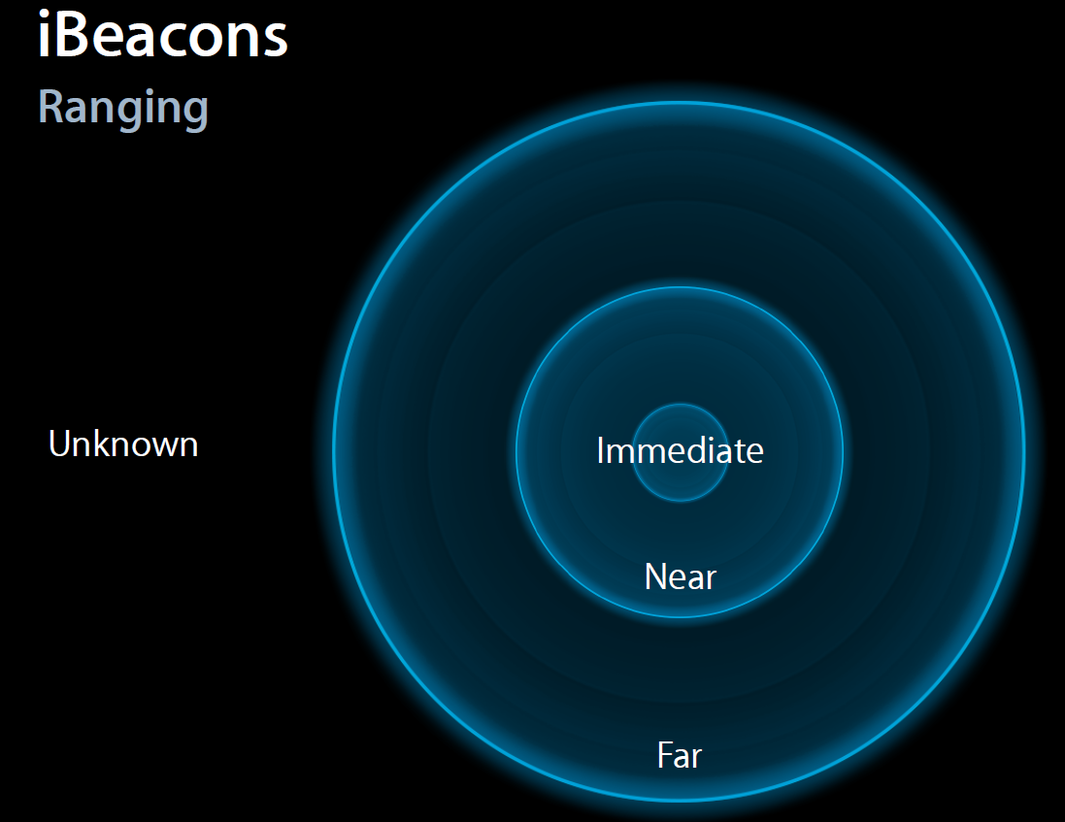
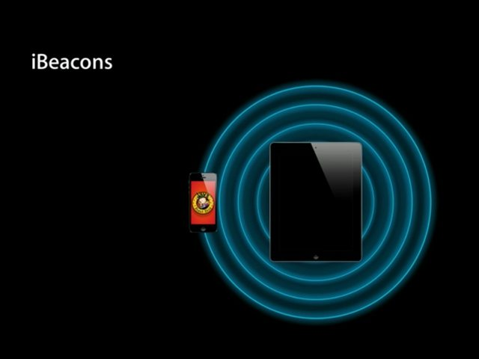
Proximity/Location awareness without GPS
This prototype allows to identify devices based on the proximity distance (classified as Immediate, Near, Far)
Devices running on iOS 7 eligible to use this technology
The feature can be used to enable indoor navigation similar such as an airport or underground subway station where GPS signals aren't available, or specifically to enhance navigational accessibility
We used Merci Check In App
To act as a “Beacon Transmitter” which transmits signature Bluetooth signal creating “micro locations” AND a “Beacon Receiver” to listen to these signature signals and can identify location within a micro radius
Based on this identification of devices we can extend the geo-fencing prototype to send notifications

Slide 11
Indoor maps
Prototype #1
Using visioglobe
Provides digital indoor map solution, from map management to map visualization
Provided us the airport maps of MAD, GVA, CPH, FRA, LHR & CDG
Features
Download from the server on demand from within our hybrid application (Phonegap + Aria templates) and load the map using phonegap plugin
Prototype #2
Using Insiteo
Provides indoor positioning and location based services
Integrates with Insiteo’s SDK to validate the use cases of positioning and navigation inside an airport or mall, using 2D maps

Slide 12
Using iAd and Apple push notifications for SQ
A concept was worked on, in combination with MeRCI and NBU
To showcase multi-fold benefits for Airlines, Amadeus & Ad services
Using iAD from Apple
The main use case was
Airlines creates the Ads and Publish to Ad hosting server
Ads are displayed on Mobile Apps
When user selects, Ads can be added to Passbook
Passbook notifies user based on rules chasing/pushing the user to redeem the vouchers etc

Slide 13
Schedule change via Push Notification
Worked with AACC/ATR/OPS teams on
To enable PNR or booking related notifications to devices from server-side (airlines).
Used Merci Check-in application as the sample app on device to register and receive the push notification for a PNR schedule change event
A Java based web application was developed
To push & notify a sample app installed on apple devices
Using Urban Airship and Apple Push Notification Service
To enable deals-n-offers notifications to devices from server-side (travel agents, stores).
Urban Airship provides a fully scalable, cross platform push notification solution, which helps to create, deploy and maintain mobile messaging faster with less overhead cost and more flexibility.

Slide 14
Group Travel
facebook based application
mashup with fb, google maps and e-retail
The main features being
Integrated with Facebook community
Personal preferences
Organize an event and track each participant status
Location based services - travel, hotel and car services
Be a travel Sponsor
Integrate with e-retail

Slide 15
Social media integration
We have developed multiple prototypes to
Share trip photos to Facebook
Share itinerary to Facebook
Share on twitter
Share on linked-in

Slide 16
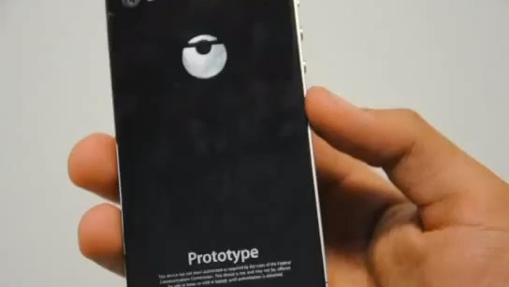
MORE IN DEVELOPMENT …

Slide 17
© 2012 Amadeus IT Group SA

